Slide 1
ADVANCED TECHNICAL TRANING CENTER
ATTC COMMUNITY FORUM
Presented by:
Andronicus Lepcha A18DCE-04
Sachin Kumar Sharma A18DCE-36
Rose Mary Rai A19DCEL-02
Manish Kumar Dhobi A18DCE-20
Under the guidance of
Mr. Nirnay Pradhan
(Lecturer)ATTC , Bardang

Slide 2
CONTENTS
Introduction
Languages Used
Framework Used
Software Used
Problem Definition
Problem Analysis
Modules
Solution Strategy
Methodology
ER Diagram
Gantt Chart
Use case Diagram
Conclusion

Slide 3
INTRODUCTION
“ATTC Community Forum ” is a web-based platform where persons after creating their account can make discussions on various topics. It’s a community discussion forum, where all the teachers, staff, and students will able to both enter questions and get answers on various categories and other tags. For example, the categories can be related to sports, admission, accounts, subjects, etc.

Slide 4
LANGUAGES USED
HTML 5.0 :The Hypertext Markup Language or HTML is the standard mark up language for documents designed to be displayed in a web browser.
PYTHON: Python has a simple syntax similar to the English language. Python has syntax that allows developers to write programs with fewer lines than some other programming language

Slide 5
CASCADING STYLE SHEET: - Cascading Style Sheets is a simple mechanism for adding style e.g., fonts, colors, spacing) to Web documents.

Slide 6
framework used
DJANGO: Django is a high-level Python Web framework that encourages rapid development and clean, pragmatic design.
BOOTSTRAP: Bootstrap is a free and open source front end development framework for the creation of websites and web apps.

Slide 7
software used
Visual Studio Code: it is is a freeware source-code editor made by Microsoft for Windows, Linux and macOS . Users can change the theme, keyboard shortcuts, preferences, and install extensions that add additional functionality.

Slide 8
PROBLEM DEFINITION
We do not have any such platform for asking and answering questions online.
A small group of faculties answering and clearing all the doubts.
Students are relying on wrong information spread by unauthorised users.

Slide 9
PROBLEM ANALYSIS
Users can ask information like college reopening date, library related queries , sports queries or even examination dates and many more related to college.
Users can filter question based on their categories.
Users can search question or answers from all the categories and tags.

Slide 10
MODULES
User verification
Easy to use user interface
Feedback (using up votes and down votes)
Useful resources links
Filter(search, categories, and tags)
Media(images and GIF’s)
Email Verification

Slide 11
SOLUTION STRATEGY
A verified mark will be there on the authorised user: With the help of this feature we all can see is the post from a verified person or not mostly the verified mark will be on the teachers account and the executive body of the institution.
Users can up vote and down vote post:This feature can help the person to see which of the post is mostly genuine if it has more Up Votes then they can say it’s more genuine.

Slide 12
methodology
In this web-based Online Community Forum, there will be four types of users who will interact with this system and control the various activities.
Users will be responsible to enter questions in a particular forum, get their answers, make replies to existing posts, check votes of different posts, and make changes through their profile settings.
It’s the admin, who will have the authority to remove questions and answers posted by the registered users or even removing the users.

Slide 13
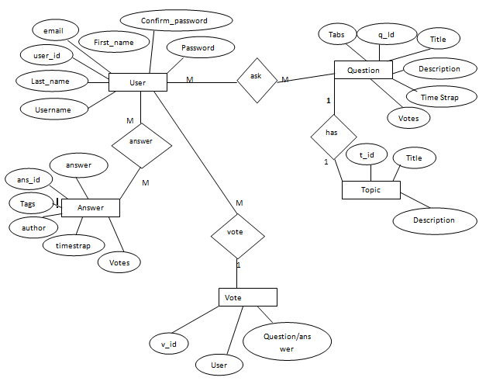
er diagram

Slide 14
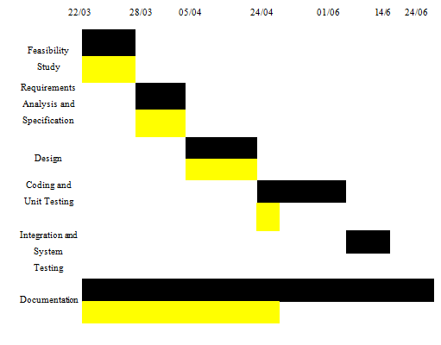
gantt chart
Proposed Activity
Achieved Activity

Slide 15
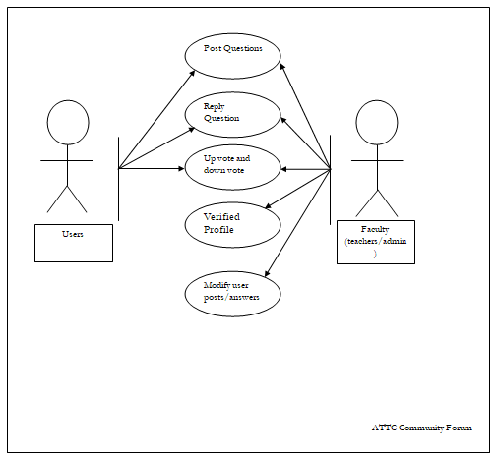
use case diagram

Slide 16
conclusion
Hence, ATTC Community Forum can be useful in educational institution like colleges and schools. It’s also a great way for students to feel more engaged in participating in the group discussion; allow them to provide and share their opinions with others at any time and location.

Slide 17
THANK YOU

